Slide 1
FEM 3105- STRESS & COPING
WEEK 3
MODELS OF STRESS PROCESS, COPING & ADJUSTMENT

Slide 2
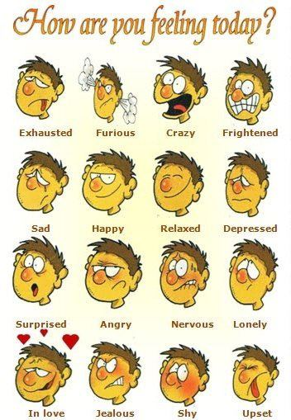
How are YOU today?

Slide 3

STRESS MODELS
STRESSOR→ PHYSIOLOGICAL RESPONSE
PHYSIOLOGICAL RESPONSE→ SUBJECTIVE FEELINGS
SUBJECTIVE FEELINGS→ BEHAVIOR
*Similar to emotional response but generally seen to be negative and to require some coping strategy

Slide 4
SUBJECTIVE-COGNITIVE APPRAISAL MODEL
EMOTIONAL
RESPONSE
SUBJECTIVE
COGNITIVE
APPRAISAL
STRESSOR
PHYSIOLOGICAL
RESPONSE
BEHAVIORAL
RESPONSE

Slide 5
CONT (Subjective-Cognitive Appraisal Model)…
POTENTIALLY
STRESSFUL
OBJECTIVE
EVENT
A major exam,
a big date, trouble with
The boss, or financial
Setback, which may
lead to frustration,
Conflict, change, or
pressure
Emotional
Response
Annoyance, anger,
anxiety, fear
SUBJECTIVE
COGNITIVE
APPRAISAL
Personalized perceptions
of threat, which are
Influenced by familiarity
with the event, its
Controllability , its
predictability, and so on
Physiological
Response
Autonomic arousal
Hormonal fluctuations
Behavioral
Response
Coping efforts, such as
Blaming oneself, seeking
Help, solving problems

Slide 6
HANS SELYE’S MODEL : GAS
GAS is the three-stage process that describes the physiological changes the body goes through when under stress.
Hans Selye, a medical doctor and researcher, came up with the theory of General Adaption Syndrome or GAS
It is split into three stages:
The first stage is the ALARM STAGE
The second stage is the RESISTANCE STAGE where the body focuses its resources to battle the stressor.
The final stage is the EXHAUSTION STAGE, where the body can no longer resist the stressor.
    The physical effects of this stage also weaken your immune system and put you at risk for stress-related illnesses.

Slide 7
LAZARUS’S TRANSACTIONAL MODEL OF STRESS
(Lazarus & Folkman)
The transactional model of stress and coping developed by Lazarus and Folkman (1987) explained coping as a phenomenon that involves both cognitive and behavioural responses that individuals use in an attempt to manage internal and/or external stressors perceived to exceed their personal resources.
Developed in 1984, Lazarus stress is defined as an “imbalance between demands and resources.”
What the two researchers meant by this was that every person has resources and skills available to them. When talking about stress, these skills are known as coping mechanisms.
A particularly stressful childhood may decrease the coping mechanism individuals have when they are adults. Either way, these coping mechanism are the resources you have when facing the demands of life.
The demands of life are everything that creates stresses. From losing a loved one to dealing with taxes, the Lazarus stress and coping theory is all about the interaction between the skills we have the stresses we face.

Slide 8
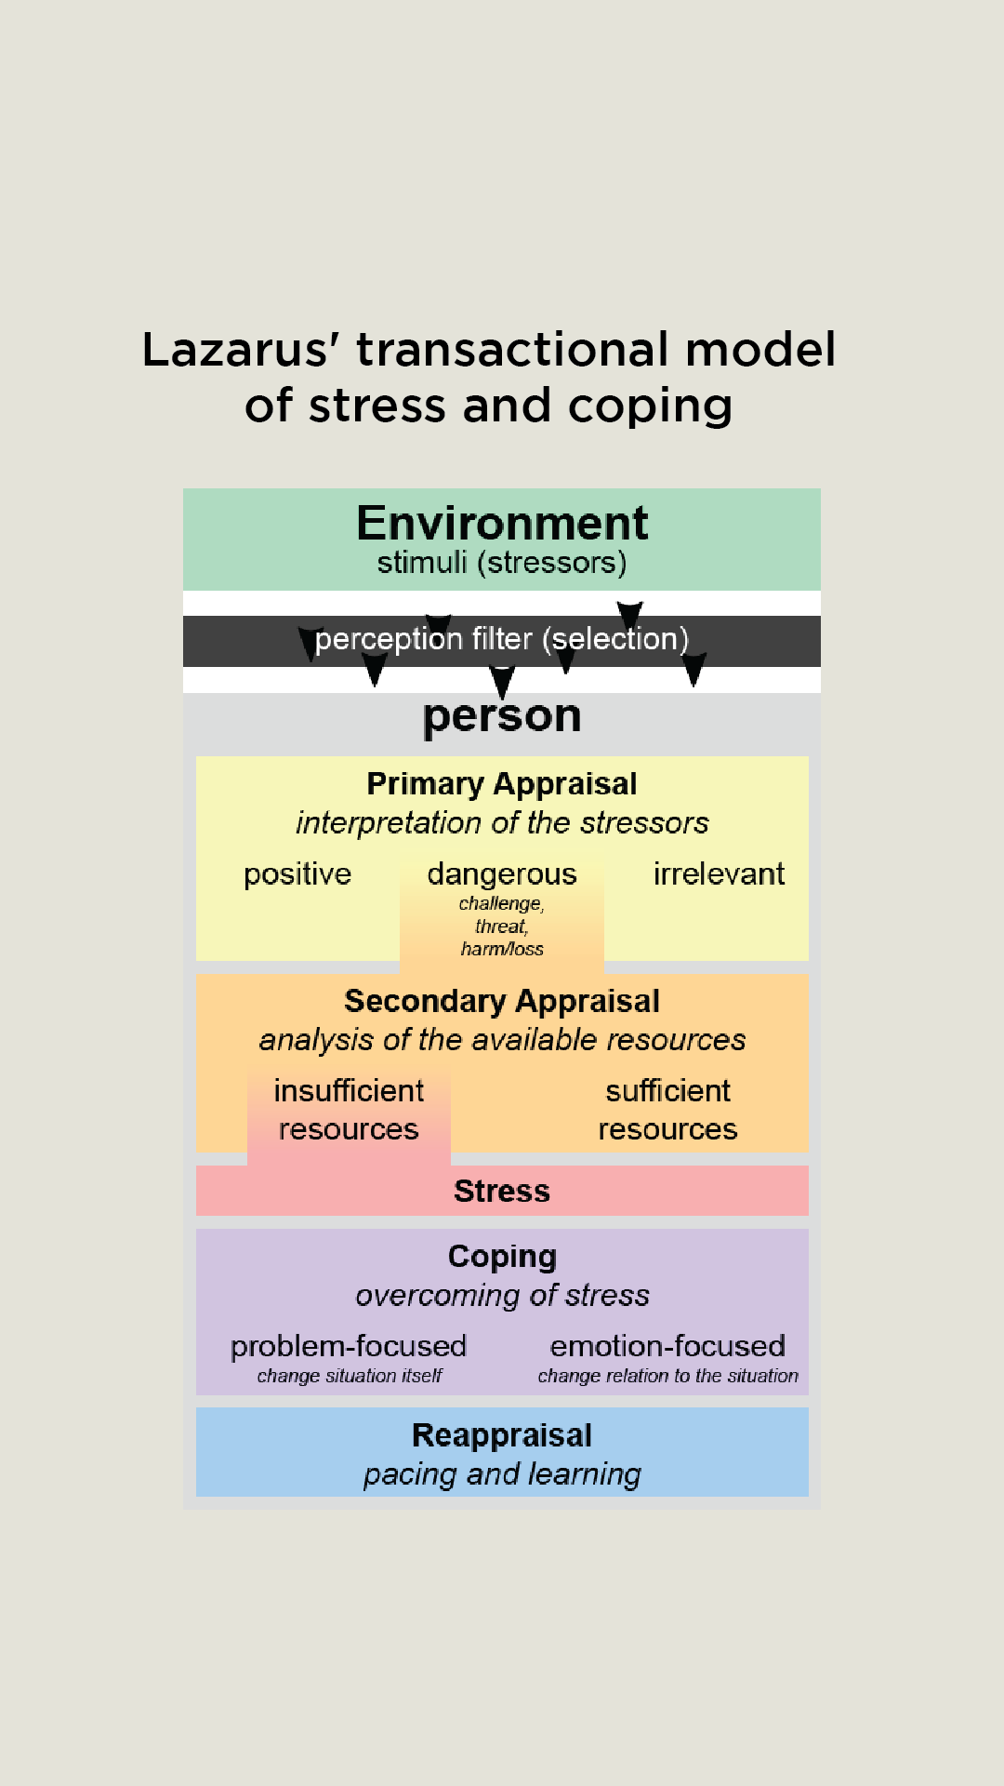
CONT… (LAZARUS’S TRANSACTIONAL MODEL OF STRESS)
Lazarus’s Model differed slightly from Selye’s. By working more with humans, he came to the conclusion that the stressor, nor the response could define stress, rather it was the individual’s perception and appraisal of the stressor that would create stress.
He realized that different individuals would look at an event differently and have different kinds of stress, positive or negative.

Slide 9
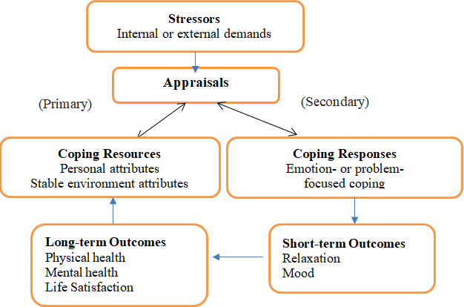
Cognitive appraisal
CONT… (LAZARUS’S TRANSACTIONAL MODEL OF STRESS)
Cognitive appraisal of stress is a two-part process which involves
  primary appraisal and
  secondary appraisal.

Slide 10
PRIMARY APPRAISAL
CONT… (LAZARUS’S TRANSACTIONAL MODEL OF STRESS)
The first stage in his model is primary appraisal where the subject analyzes the stressor and determines if it will be positive or negative, exciting or harmful, etc.
Primary appraisal involves the determination of an event as stressful.
During primary appraisal, the event or situation can be categorized as irrelevant, beneficial, or stressful.
If the event is appraised as stressful, the event is then evaluated as either a harm/loss, a threat, or a challenge.
“Am I okay?”

Slide 11
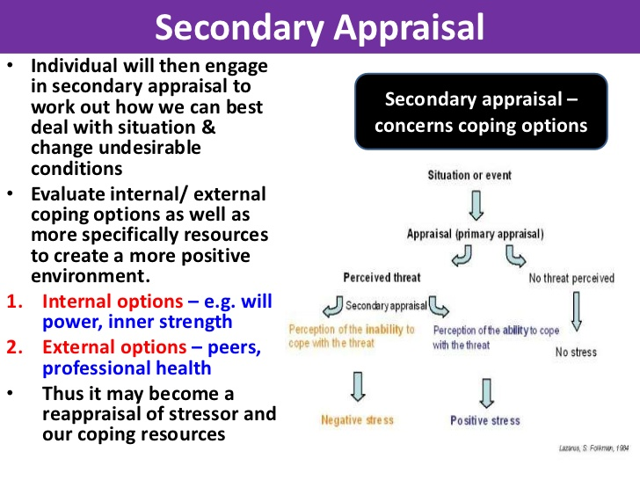
SECONDARY APPRAISAL
CONT… (LAZARUS’S TRANSACTIONAL MODEL OF STRESS)
The second stage is secondary appraisal, where the subject determines if he or she can cope with the given stressor.
Even if the stressor is determined as harmful in the first stage, if the subject decides he or she can cope with it in the second stage, stress will be kept at a minimum.
Secondary appraisal occurs after assessment of the event as a threat or a challenge.
During secondary appraisal the individual now evaluates his or her coping resources and options.
“ How much control do I have?”

Slide 12
CONT… (LAZARUS’S TRANSACTIONAL MODEL OF STRESS)
According to the theory of transactions, stress arises only when a particular transaction is appraised by the person as relevant to his or her well-being.
In order for an event to be appraised as a stressor, it must be personally relevant and there must be a perceived mismatch between a situation's demands and one's resources to cope with it.
SECONDARY
APPRAISAL
Can I cope with
the stress?
What are the a
Alternatives?
PRIMARY
APPRAISAL
Is this event beneficial,
harmful threatening,
Or challenging?
Emotions are
Generated by the
appraisal
Yes I can cope
Minimum Stress
STRESSOR
Sorry I can’t cope
I experience a lot
of Stress

Slide 13
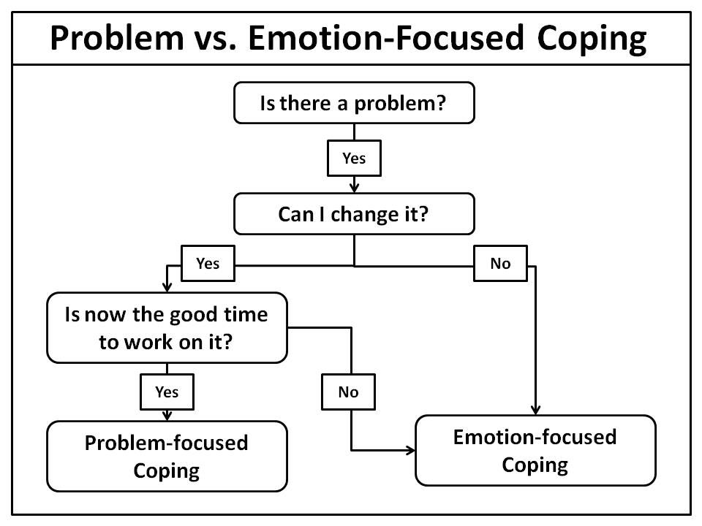
2 TYPES OF COPING RESPONSES
Lazarus and Folkman (1984) suggested there are two types of coping responses emotion focused and problem focused.

Slide 14
PROBLEM-FOCUSED COPING | EMOTION-FOCUSED COPING
is that kind of coping aimed at resolving the stressful situation or event or altering the source of the stress, consequently directly reducing the stress. | is a type of stress management that attempts to reduce negative emotional responses associated with stress.
Problem focused strategies aim to remove or reduce the cause of the stressor. Most effective when you have the personal control. | Emotion-focused techniques might be the only realistic option when the source of stress is outside the person’s control. It is used when we cannot change a stressor.
Problem-solving. Time-management Obtaining instrumental social support. | Distraction with pleasurable activities Talking with a friend Obtaining emotional support.

Slide 15
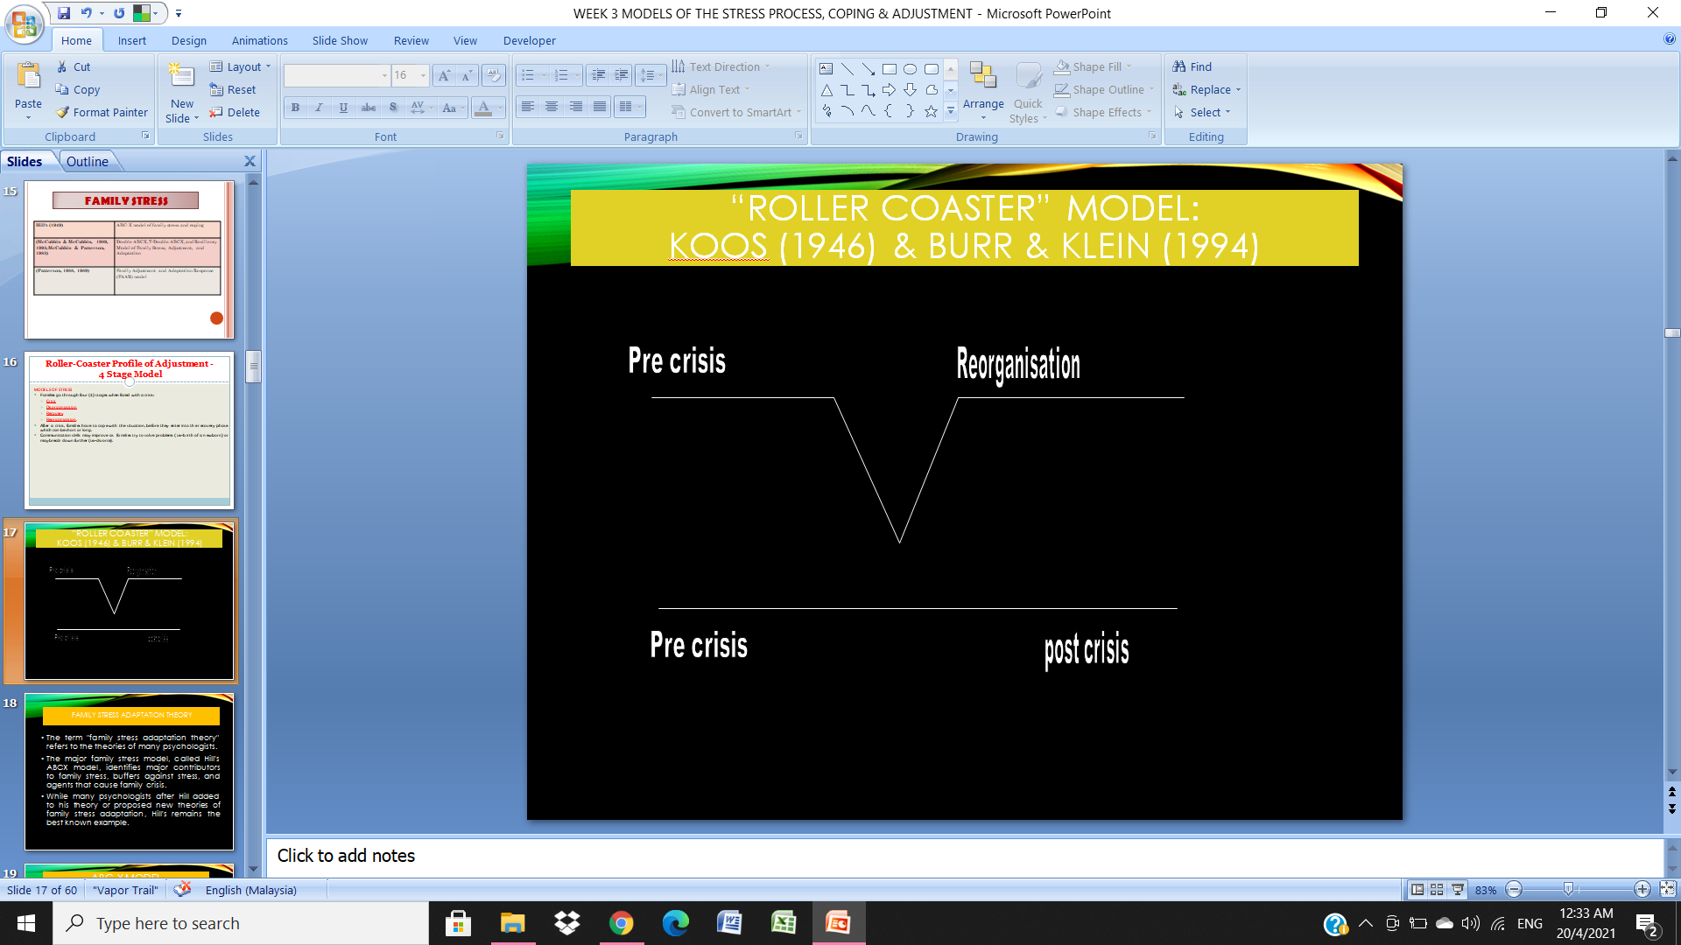
ROLLER-COASTER PROFILE OF ADJUSTMENT - 4 STAGE MODEL
FAMILY STRESS
MODELS OF STRESS
Families go through four (4) stages when faced with a crisis:
  Crisis
  Disorganization
  Recovery
  Reorganization.
After a crisis, families have to cope with the situation, before they enter into the recovery phase which can be short or long.
Communication skills may improve as families try to solve problems (i.e.-birth of a newborn) or may break down further (i.e.-divorce).

Slide 16
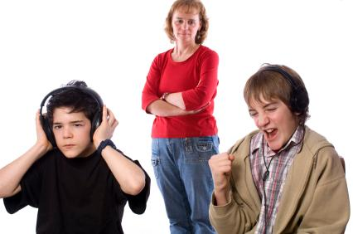
FAMILY STRESS ADAPTATION THEORY
The term "family stress adaptation theory" refers to the theories of many psychologists.
The major family stress model, called Hill's ABCX model, identifies major contributors to family stress, buffers against stress, and agents that cause family crisis.
While many psychologists after Hill added to his theory or proposed new theories of family stress adaptation, Hill's remains the best known example.

Slide 17
CONT.. (FAMILY STRESS)
Hill's (1949) | ABC-X model of family stress and coping
(McCubbin & McCubbin, 1989, 1993; McCubbin & Patterson, 1983) | Double ABCX, T-Double ABCX, and Resiliency Model of Family Stress, Adjustment, and Adaptation
(Patterson, 1988, 1989) | Family Adjustment and Adaptation Response (FAAR) model

Slide 18
ABC-X Model
(Reuben Hill, 1949)
The ABC‐X model is used for analyzing stress and coping within families.
The model consists of:
  (A) the stressor event,
  (B) the resources available to a family,
  (C) the family's perceptions of the stressor, and
  (X) the likelihood of crisis.
Variables B and C determine whether the stressor event (A) results in crisis.
The ABC‐X model has been refined through the inclusion of additional factors such as a family's social context and further developed into the double ABC‐X model by subsequent research.

Slide 19
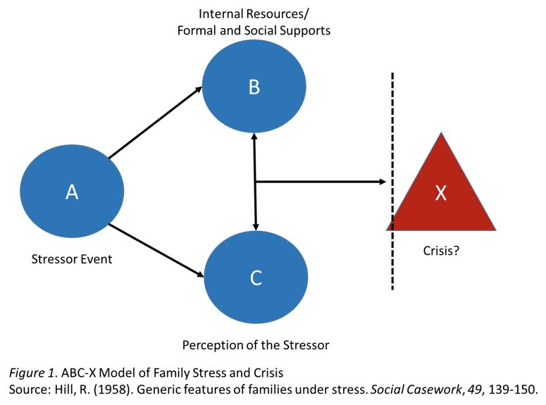
Model ABC-X
Factor X (crisis/ extreme stress) is the result of the interaction between factors A, B, & C

Slide 20
CONT…(Model ABC-X)
Reuben Hill studied families who survived the Great Depression, and contrasted these families with those families that did not remain intact after the Depression.
He developed his ABCX model of family stress and adaptation.
Hill theorized that major stressful events disrupt family equilibrium. Like any organism, the family seeks to re-establish equilibrium by using coping mechanism to handle the stress.
Stressors cited by Hill and other researchers since Hill include sudden economic hardship, divorce, physical abuse of children or spouses, illness, substance abuse and relapse, accidents and any other sudden onset events.
In Hill's model, the letter "A" refers to the event that disrupts equilibrium.
Hill cited protective factors at work within the family that help buffer it against the negative consequences of sudden stress.
Hill called one of the protective factors "B" and the other "C".
"B" factors include internal and external family resources and social support through church, community or other resources.
Continuing Hill's family stress model, the "C" factor refers to perception.
The C factor refers to shared family beliefs and perceptions of the stressor.
Hill suggested that if families perceived stressful events positively or constructively, they were better able to copy with the event. Those families that perceived and dwelled on the negative impact of the stressful event had a more difficult time coping with it.

Slide 21
DOUBLE ABC-X MODEL
(McCubbin, 1983, 1989)
The double ABC‐X model addresses post crisis coping processes that determine whether a family can adapt to a crisis.
It includes:
  (aA) the pileup of additional stressors and the original crisis;
  (bB) existing resources and resources developed in order to meet the crisis;
  (cC) a family's perceptions of the crisis, additional stressors, and its available resources;
  (xX) the likelihood of adaptation to crisis.
The ABC‐X and double ABC‐X models are influential in family research and counseling.
Using Hill’s ABCX Formula as a foundation, McCubbin and Patterson (1982, 1983b) added
  additional life stressors and strains;
  psychological, intra-familial, and social resources;
  changes in the family’s definition;
  family coping strategies; and
  a range of outcomes, with family coping strategies being the Double ABC-X Model’s major contribution to stress theory.

Slide 22
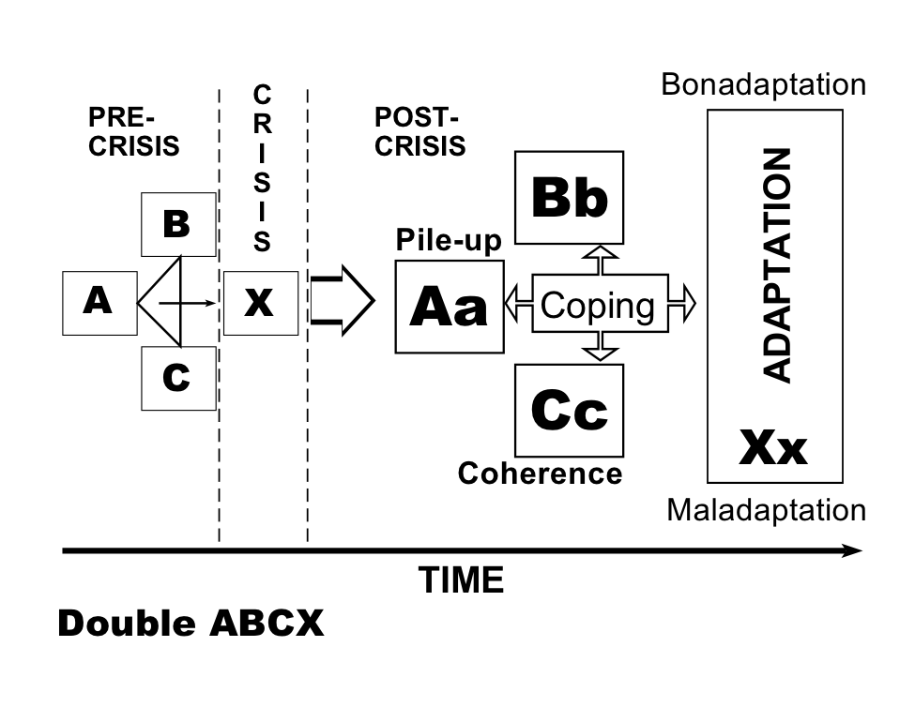
CONT…(DOUBLE ABC-X MODEL)
a A = additional stressors
b B = additional resources
c C = reinterpretations
  Coping strategies can be determined after phase 1
  Adjustments may be positive or negative

Slide 23
Summary
CONT…(DOUBLE ABC-X MODEL)
The ABCX Model began with the stressor and ended with the crisis, while the Double ABCX Model began with the stressor but went on to include postcrisis variables.
Since the ABCX Model is the basis of most family stress models, its developer, Hill (1958), has been called the father of family stress theory.

Slide 24
RESULT OF CRISIS…
ADAPTATION
  BONADAPTATION
    “Good,” positive adaptation
    Positive result to the crisis
  MALADAPTATION
    “Bad,” negative adaptation
    Unhealthy or dysfunctional resolution of the crisis

Slide 25
  BONADAPTATION
  (Positive adaptation)..
Family Adaptation
Families adapt to stress with either positive coping mechanisms or negative ones.
Examples of positive coping mechanisms include:
  Coping with the illness or injury through directly addressing its impact on the family. This may mean adding wheelchair ramps to the home, for example, to directly deal with a physical condition, or accompanying a family member to the hospital for substance abuse treatment.
  Talking among themselves or with a counselor, therapist, or clergy person about the problem
  Seeking help for substance abuse problems or domestic problems
  Turning to family, neighbors, community or church members for support and encouragement

Slide 26
MALADAPTATION
(Negative adaptation)
Examples of maladaption include:
  Denying the problem exists
  Using drugs, alcohol, or other addictive substances to numb the pain or stressful feelings
  Avoiding discussion of the event
  Isolating from family or friends, perhaps out of embarrassment or even exhaustion at coping with the problem
  Hiding the problem (as in the case of addictions or domestic violence)
  Escaping through too much television, movies or other normally harmless entertainment
  Projecting feelings of anger or frustration onto other family members, as in the case of a mother yelling at her children when in fact she is angry with a situation beyond her control, such as loss of a job.

Slide 27
OTHER HYBRID MODELS…

Slide 28
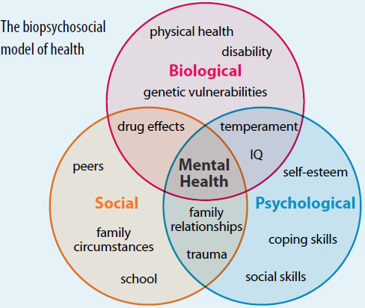
BIO-PSYCHOSOCIAL MODEL
Health (and illness) are caused/influenced by many factors.
  Mind and body are not separate
  Relationships are significant to health
Health is on a continuum
The Bio-psychosocial model is a conceptual model that suggests that in understanding a person's medical condition it is not simply the biological factors to consider, but also the psychological and social factors
  Bio (physiological pathology)
  Psycho (thoughts emotions and behaviours such as psychological distress, fear/avoidance beliefs, current coping methods and attribution)
  Social (socio-economical, socio-environmental, and cultural factors suchs as work issues, family circumstances and benefits/economics)

Slide 29
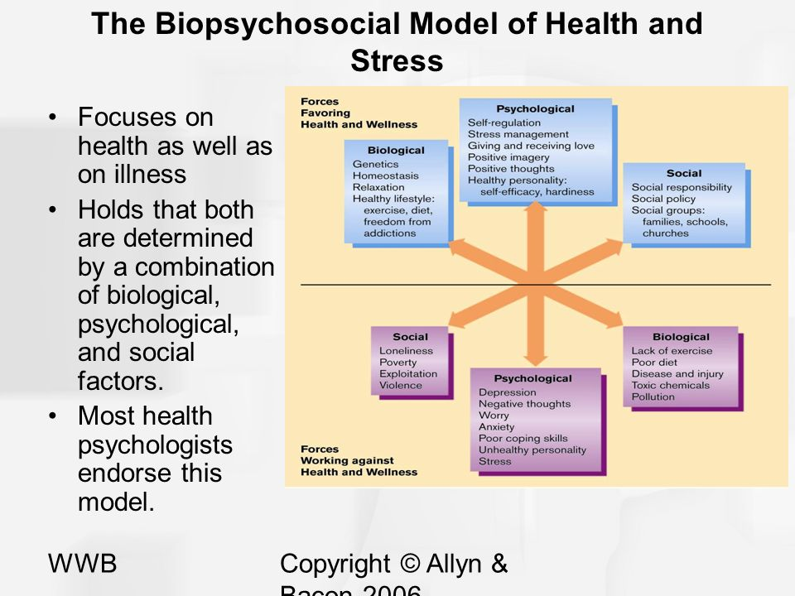
Biopsychosocial Model of Stress
(Bernard & Krupat, 1994).
Stress involves three components:
an external component
an internal component
and the interaction between the external and internal components

Slide 30
BIO-PSYCHOSOCIAL MODEL
OF DISEASE
BIOLOGY
Age, sex
Disease state
Genetics/heredity
Physical symptoms
Meds/drugs/addiction
PSYCHOLOGY
Attitudes/beliefs
Mood state
Behaviors
Religiosity/spirituality
ENVIRONMENT
School/work place
Social norms / cultural norms
Community / Health services
Neighborhoods / National economy
Mass media
Policy / laws
SOCIAL
Support: formal/informal
Roles: work/family/peers
relationship
Socioeconomic status

Slide 31
MULTISYSTEM ASSESSMENT OF STRESS AND HEALTH (MASH) MODEL
The MASH Model builds upon previous stress research to form a comprehensive bio-psychosocial model of stress and health (Aldwin, 1994; Boss, 1989; Doherty & Campbell, 1988).
Earlier work in the field of stress concentrated on stress and coping at only one conceptual level, most often at the personal level or in a work setting (Aldwin, 1994).
The Multisystem Assessment of Stress and Health (MASH) model builds a bio-psychosocial model that is multidimensional and is designed to bridge research, theory, and practice.
The model builds on the earlier family theory and research focusing on stress, coping and adaptation with individuals, couples and families.
The model is multidimensional and utilizes a multisystem perspective including four areas of life: personal, work, couple, and family.

Slide 32
The Four Key Coping Resources (MASH)
The MASH Model contains three primary components: stress, coping resources, and satisfaction, which are assessed at four levels of a person’s life: personal, work, couple, and family
Stress is assessed at the personal, work, couple and family level.
Coping resources are organized into a skill dimension and a relationship dimension.
The skill dimension includes problem Solving and Communication.
The two relationship dimensions focus on the concepts of Closeness (cohesion) and Flexibility.
Each of these four resources are assessed at all four levels, thereby developing sixteen coping resources.
(1) Problem Solving -- the ability to deal directly with, not avoid, the problems you face and make positive changes to resolve them.
(2) Communication -- the ability to honestly share thoughts and feelings with others to promote mutual understanding.
(3) Closeness -- a comfort level with others and the ability to connect with people in your environment.
(4) Flexibility -- an openness and ability to respond to change.

Slide 33
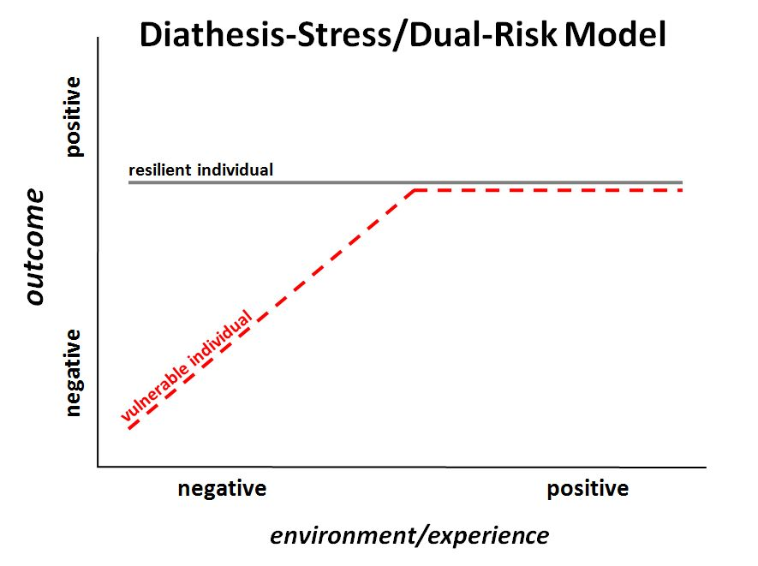
THE DIATHESIS–STRESS MODEL
The diathesis–stress model is a psychological theory that attempts to explain a disorder as the result of an interaction between a predispositional vulnerability and a stress caused by life experiences.
The term diathesis derives from the Greek term (διάθεσις) for a predisposition, or sensibility.
A diathesis can take the form of genetic, psychological, biological, or situational factors.
A large range of differences exists among individuals' vulnerabilities to the development of a disorder.
“The term diathesis is synonymous with vulnerability”!!
A psychological theory that explains behavior as both a result of biological and genetic factors ("nature"), and life experiences ("nurture").
This theory is often used to describe the pronunciation of mental disorders, like schizophrenia, that are produced by the interaction of a vulnerable hereditary predisposition, with precipitating events in the environment.

Slide 34
CONT…(THE DIATHESIS–STRESS MODEL)
According to this model a mental disorder (illnesses or diseases that have prominent emotional, behavioral, and psychological symptoms) or other psychopathology (the specific manifestations, morbid or sick behaviors, thoughts, emotions) occurs when an individual with a diathesis (a tendency, vulnerability, or predisposition) is exposed to a stress.
Individuals inherit tendencies to express certain traits or behaviors, which are then expressed or activated under conditions of stress.
The diathesis, or predisposition, interacts with the individual's subsequent stress response.
Stress is a life event or series of events that disrupts a person's psychological equilibrium and may catalyze the development of a disorder.
Thus the diathesis–stress model serves to explore how biological or genetic traits (diatheses) interact with environmental influences (stressors) to produce disorders such as depression, anxiety, or schizophrenia.
The diathesis–stress model asserts that if the combination of the predisposition and the stress exceeds a threshold, the person will develop a disorder.

Slide 35
CONT…(THE DIATHESIS–STRESS MODEL)
The use of the term diathesis in medicine and in the specialty of psychiatry dates back to the 1800s; however, the diathesis–stress model was not introduced and used to describe the development of psychopathology until it was applied to explaining schizophrenia in the 1960s by Paul Meehl.
The diathesis–stress model is used in many fields of psychology, specifically for studying the development of psychopathology.
It is useful for the purposes of understanding the interplay of nature and nurture in the susceptibility to psychological disorders throughout the lifespan.
Diathesis–stress models can also assist in determining who will develop a disorder and who will not.
For example, in the context of depression, the diathesis–stress model can help explain why Person A may become depressed while Person B does not, even when exposed to the same stressors.

Slide 36
CONT…(THE DIATHESIS–STRESS MODEL)
More recently, the diathesis–stress model has been used to explain why some individuals are more at risk for developing a disorder than others.
For example, children who have a family history of depression are generally more vulnerable to developing a depressive disorder themselves.
A child who has a family history of depression and who has been exposed to a particular stressor, such as exclusion or rejection by his or her peers, would be more likely to develop depression than a child with a family history of depression that has an otherwise positive social network of peers.
Diathesis–stress models are often conceptualized as multi-causal developmental models, which propose that multiple risk factors over the course of development interact with stressors and protective factors contributing to normal development or psychopathology.

Slide 37
GENETIC VS. ENVIRONMENT
Some mental illnesses are caused mostly by genetic (predisposed) factors while others are primarily learned (environmental).
Most mental illnesses, however, are a result of the combination of genetics and learning. Whether an individual gets a mental illness or not depends on which factors affect them most.
Most likely to get mental illnesses
  HIGH genetic predisposition
  HIGH amount of stress
Least likely to get mental illnesses
  LOW genetic predisposition
  LOW amount of stress

Slide 38
IMPLICATIONS
Consider biological, psychological, and social factors
Relationships are significant to health
Keep people healthy rather than wait to treat them when they become ill.

Slide 39

CONCLUSION
Stress (and coping model) can be categorized into 3 broad approach:
1. Live events model (objective)
2. Cognitive model (subjective)
3. Stimulus model (interactional)
Phases
Combination of model
Lets reduce our stress!!
THE END
THANK YOU

